Slide 1
Project „ACH“ (Applied Crypto Hardening)
www.bettercrypto.org

Slide 2

Motivation

Slide 3
Don‘t give them anything for free
It‘s your home, you fight

Slide 4
TL;DR - Quickinfos
Website: www.bettercrypto.org
Git repo: https://git.bettercrypto.org
Mailing list: http://lists.cert.at/cgi-bin/mailman/listinfo/ach

Slide 5
Idea
(Aaron)
Do at least something against the Cryptocalypse
Check SSL, SSH, PGP crypto Settings in the most common services and certificates:
Apache, Nginx, lighthttp
IMAP/POP servers (dovecot, cyrus, ...)
openssl.conf
Etc.
Create easy, copy & paste-able settings which are „OK“ (as far as we know) for sysadmins.
Keep it short. There are many good recommendations out there written by cryptographers for cryptographers
Many eyes must check this!

Slide 6
Table of contents so far
Disclaimer
Methods
PKIs
Elliptic Curve Cryptography
Key lengths
Random Number Generators
Cipher suites
Recommendations on practical settings
Tools
Links
Reviewers
Notes:
Green == main chapter

Slide 7
Additionally covered in this talk
Attacks: BEAST, CRIME etc.

Slide 8
Methods
(Aaron)

Slide 9

Previous work
(Aaron)
Qualys blog / book (Ivan Rstic):
SSL/TLS Deployment Best Practices
OpenSSL Cookbook
ENISA recommendations: Algorithms, Key Sizes and Parameters Report
BSI: Technische Richtlinie TR-02102-2, Kryptographische Verfahren: Empfehlungen und Schlüssellängen. Jan. 2013
G-sec.lu (Thierry Zoller): TLS/SSL hardening and compatibility Report 2011
NIST: Recommendation for Key Management, July 2013

Slide 10
Some thoughts on ECC
(Azet)

Slide 11
Some general thoughts on settings
Ramin
General
Disable SSL 2.0 (weak algorithms)
Disable SSL 3.0 (BEAST vs IE/XP)
Enable TLS 1.0 or better
Disable TLS-Compression (SSL-CRIME Attack)
Implement HSTS (HTTP Strict Transport Security)
Variant A: fewer supported clients
Variant B: more clients, weaker settings

Slide 12
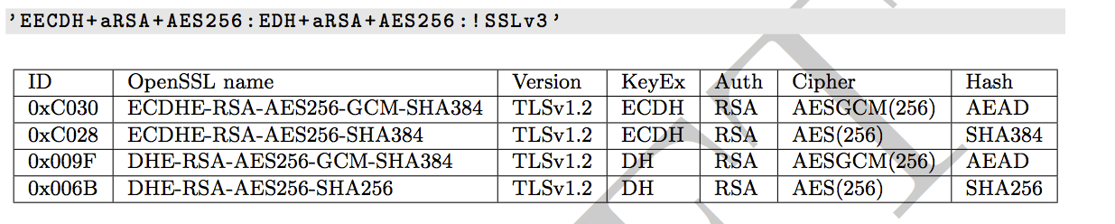
Strong settings. Variant A

Slide 13
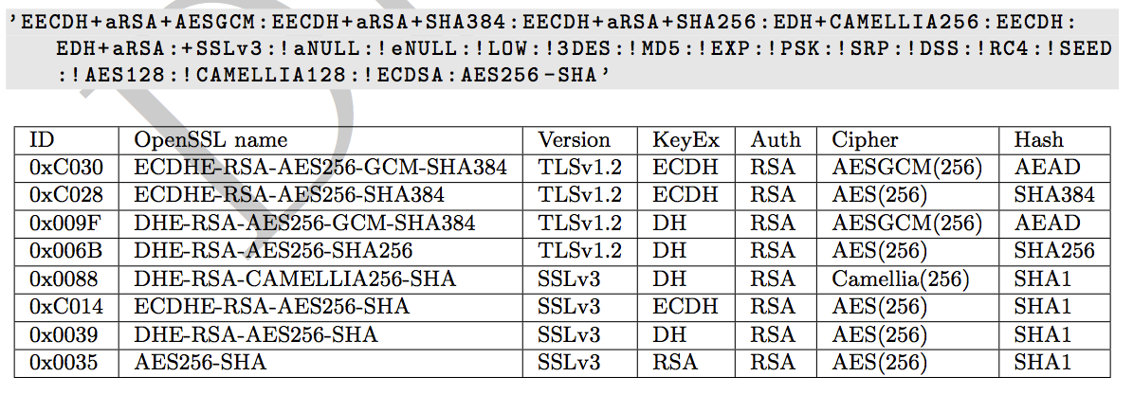
Weaker, compatible settings, Variant B

Slide 14
Random Number Generators
Azet

Slide 15
Keylengths
(cm, Azet)

Slide 16
A brief overview of common crypto software: libraries
(cm, Adi)

Slide 17
Attacks: BEAST, CRIME etc.
(Azet)

Slide 18
Testing testing testing

Slide 19
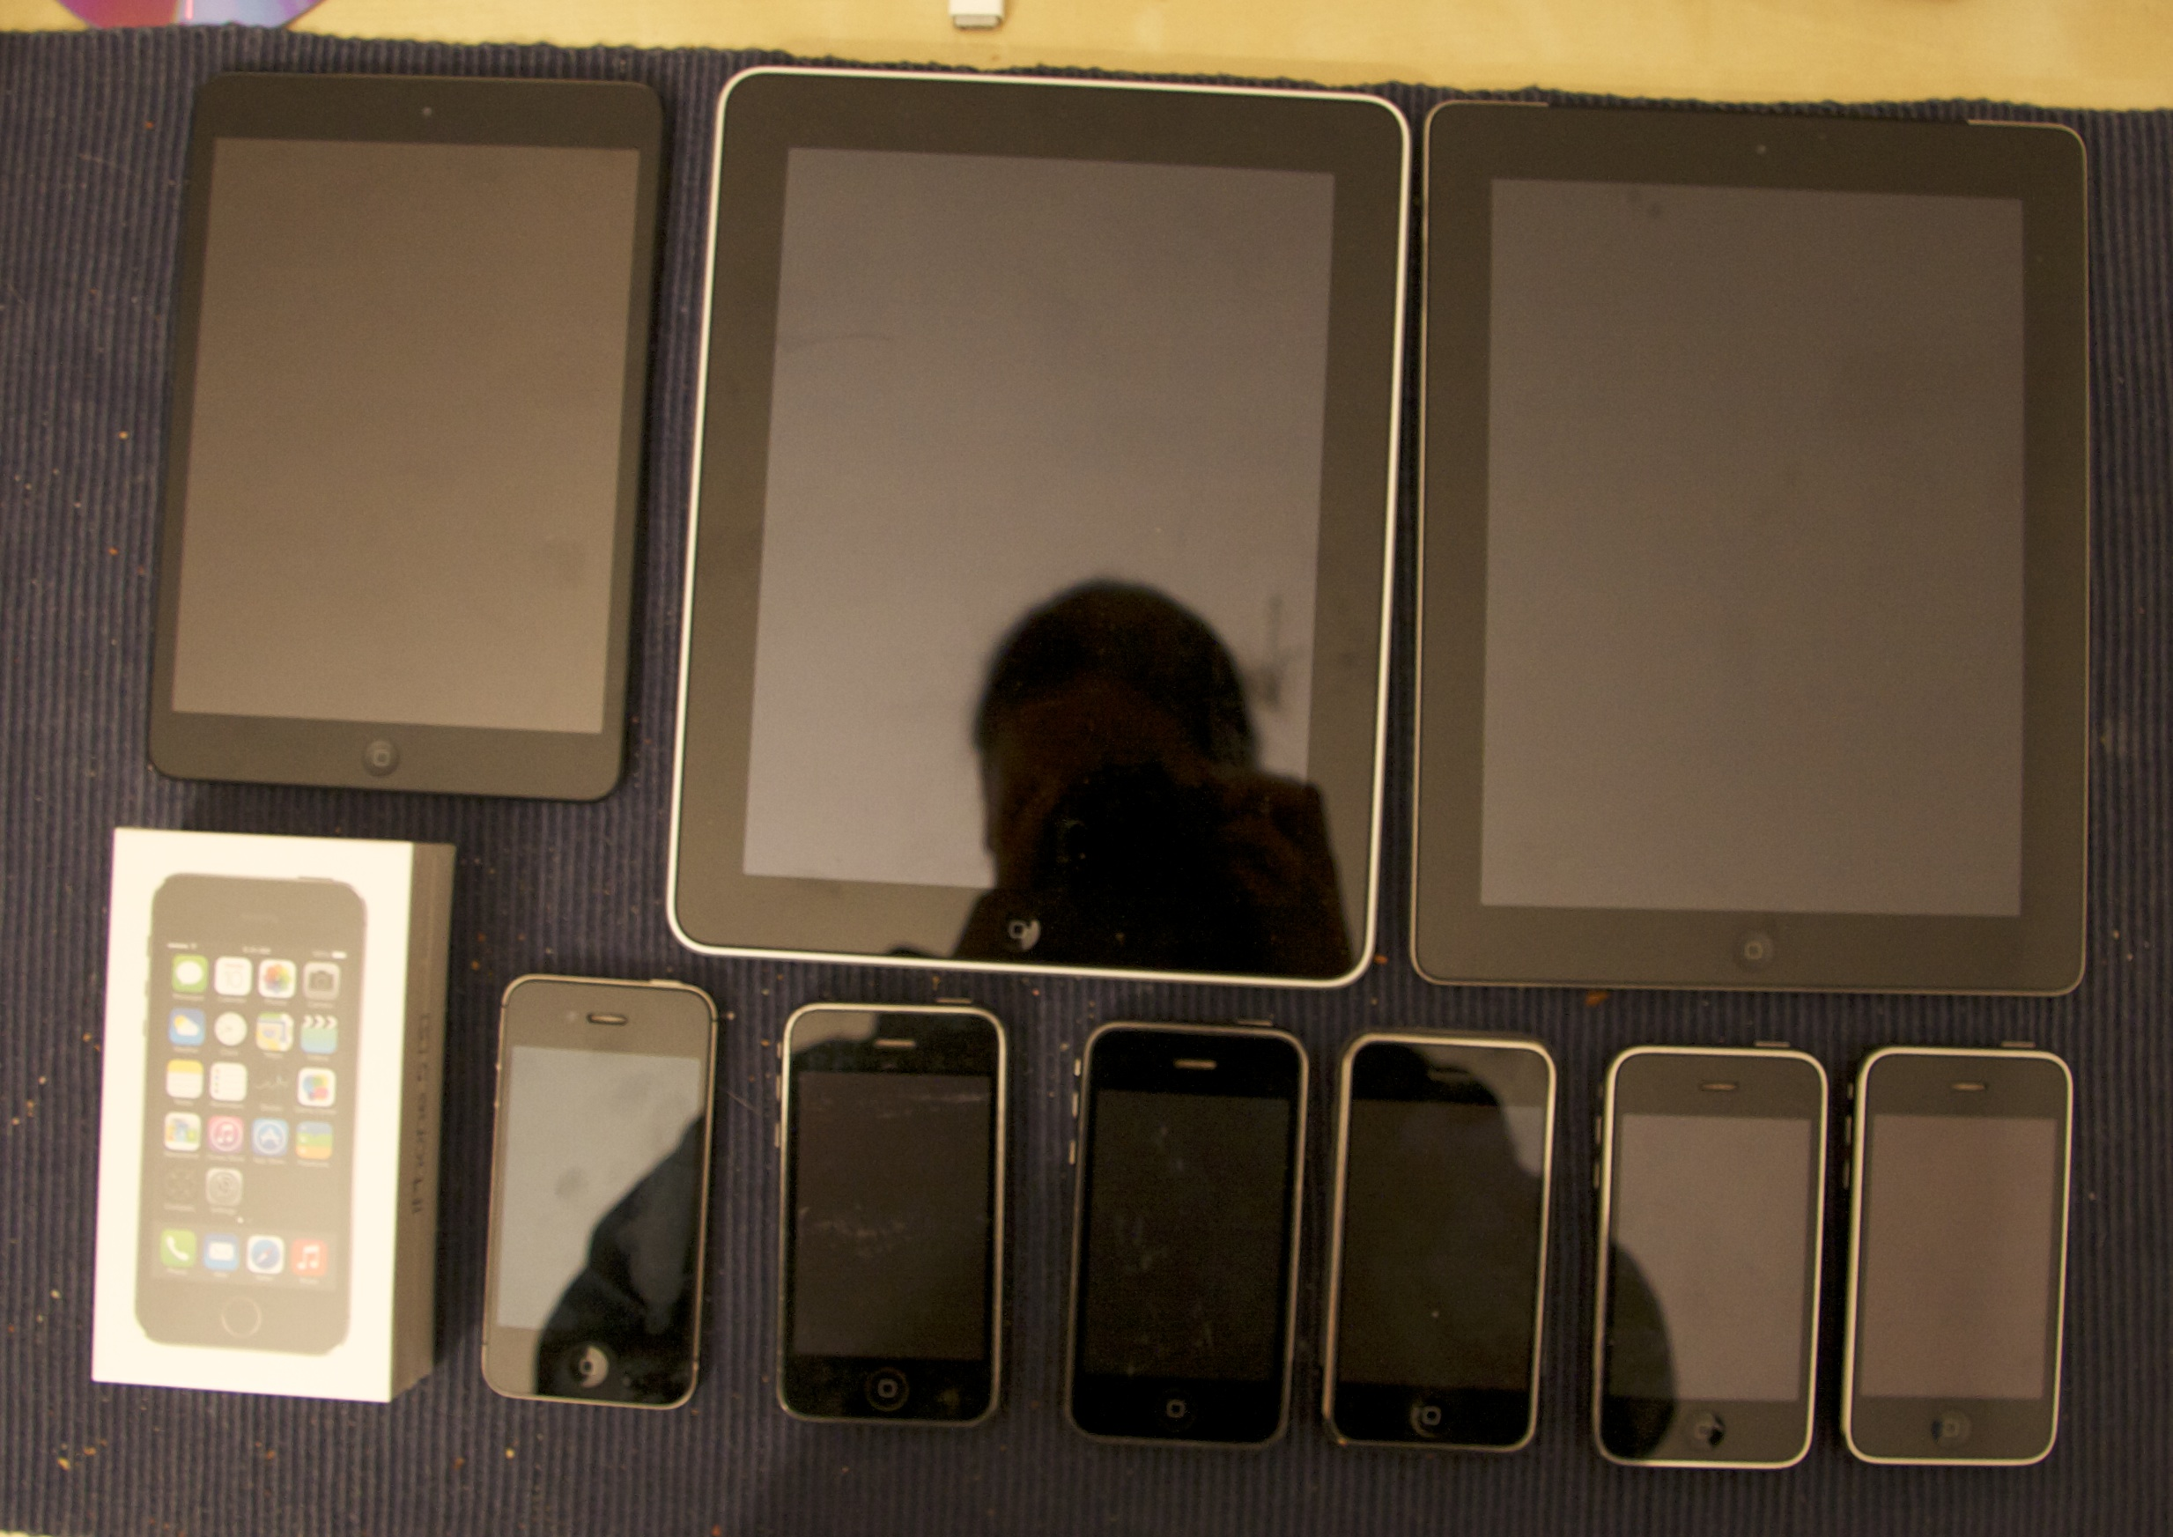

Slide 20
How to test? - Tools
(Pepi)
ssllabs.com
xmpp.net
Sslscan (CLI tool)
What can people do to test themselves?
What does a test result mean?
Potential for a config file generator (as discussed)?

Slide 21
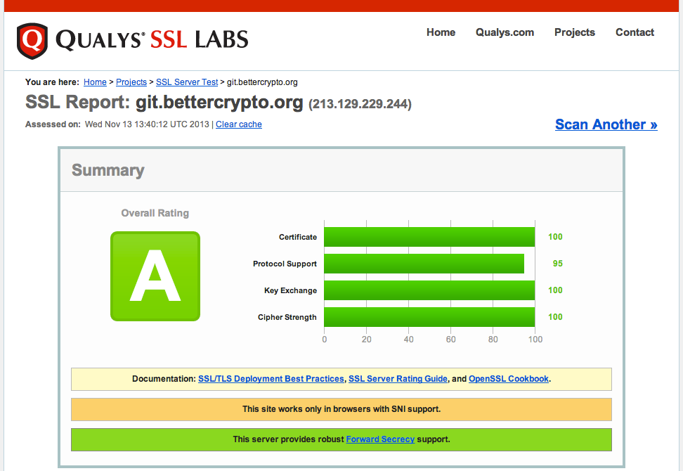
Ssllabs.com Example

Slide 22
Recommendations on practical settings – our findings so far
Apache (Adi, Azet)
Nginx (Adi, Pepi)
MS IIS (Ramin)
Postfix , dovecot (cm)
Opportunistic TLS, what is that? (cm)
ssh (Azet)

Slide 23
Current state as of 2013/11/13
Initial ongoing work in the git repository
More testing needed. Especially compatibility with clients and when to simply ignore old clients (RC4,...)
Need to fill in other sections (PGP, Exchange server, ...)

Slide 24
Practical settings – still missing
UW, Cyrus
Exim4
OpenVPN – troubles on mac (pepi)
IPSec
vendor specific applications: Juniper VPN, Cisco...
Proxies (squid)
Exchange
PGP

Slide 25
Participation
Authors: cryptologists, sysadmins, hackers
Apply for write-perms
World-readable
Variantes:
(A) reviewer: the harder job ;-)
(B) co-author: add a section

Slide 26
Links
Website: www.bettercrypto.org
Git repo: https://git.bettercrypto.org/ach-master.git
Mailing list: http://lists.cert.at/cgi-bin/mailman/listinfo/ach

Slide 27
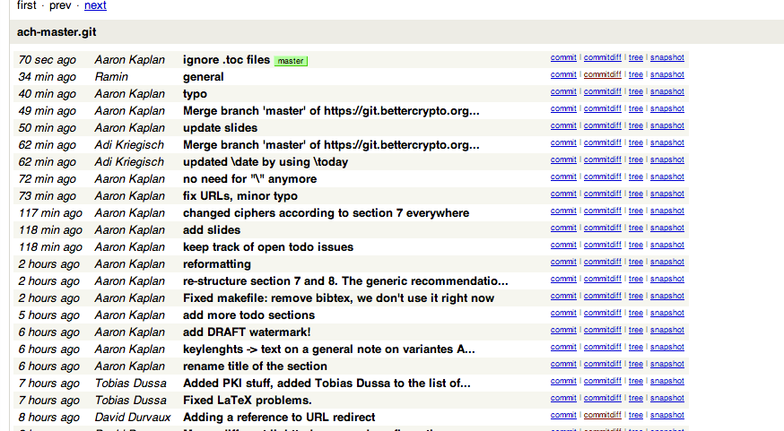
Git Repo

Slide 28
Thank you!
Authors:
L. Aaron Kaplan kaplan@cert.at
Manuel Koschuch
Adi Kriegisch adi@kriegisch.at
Christian Mock
Ramin Sabet
Aaron Zauner <azet.org>
Pepi Zawodsky pepi@maclemon.at

